Slide 1
Statistical Analysis on Fundamental reactions in Kinetics using Weighted Relative Error Least Square Fitting

Slide 2
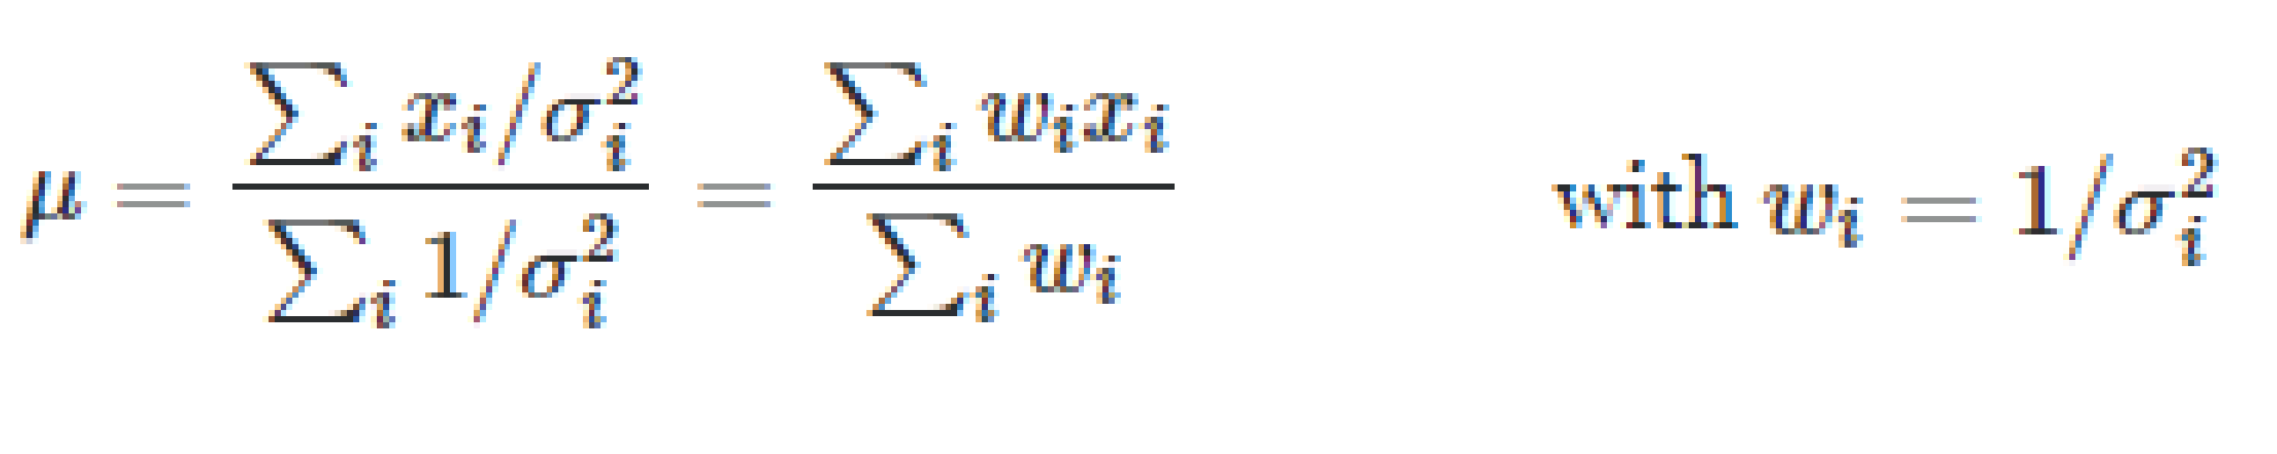
Weighted average and least square fitting
Collect all kinetic data and associated uncertainties from shock tube and flow reactor experiments (right figure)
Weighted average of each data at specific temperature and pressure (maximum likelihood principle)
Output as evaluated experimental rate : Green line (in left figure) with red cross as the 1-σ upper and lower uncertainty
Weighted least square fitting of the evaluated experimental rates to produce Arrhenius parameters and uncertainty → Blue line (in left figure)
Considered cases that experimental data don’t agree with each other at all. Data consistency uncertainty
Main advantages: 1) free of personal preference. Objective and automated. 2) robust statistical base and can evolve with new data flowing in

Slide 3
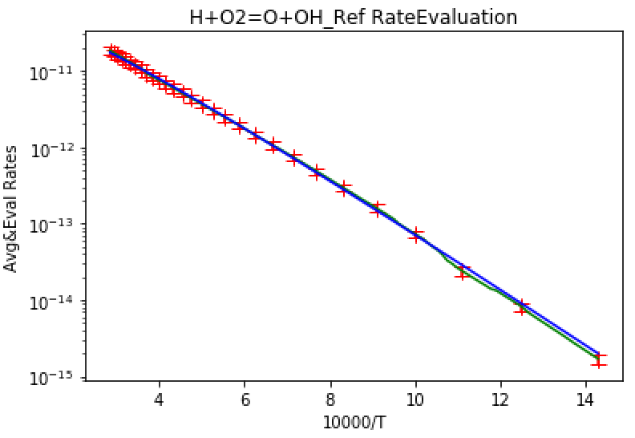
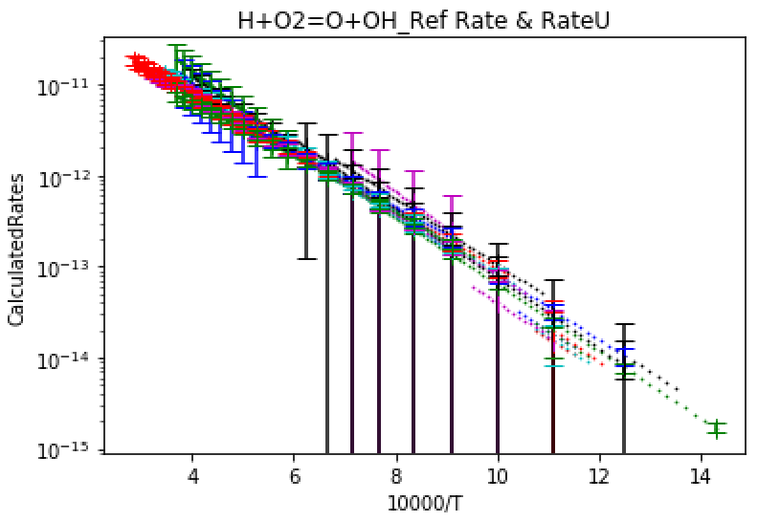
Rate evaluation example: H + O₂ = O + OH reaction
A: 1.27(±0.12)E-09 cm3/molecule/s
n: -0.708 (±0.033)
E: 74.20(±0.5) kJoule/mol

Slide 4
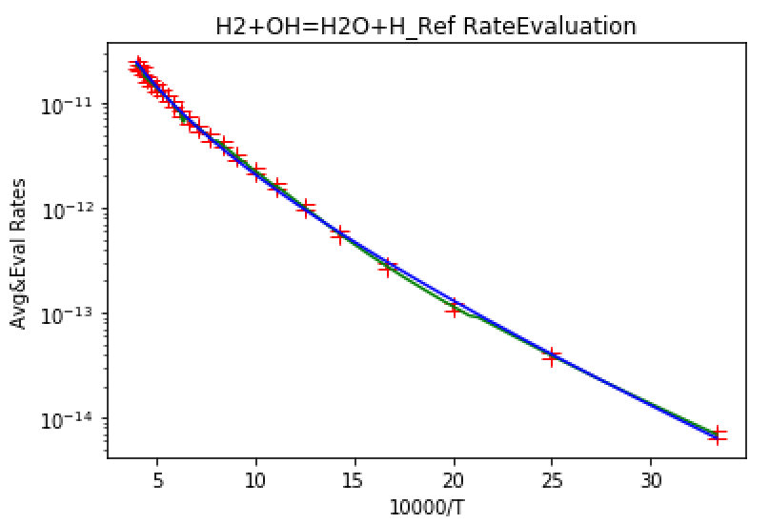
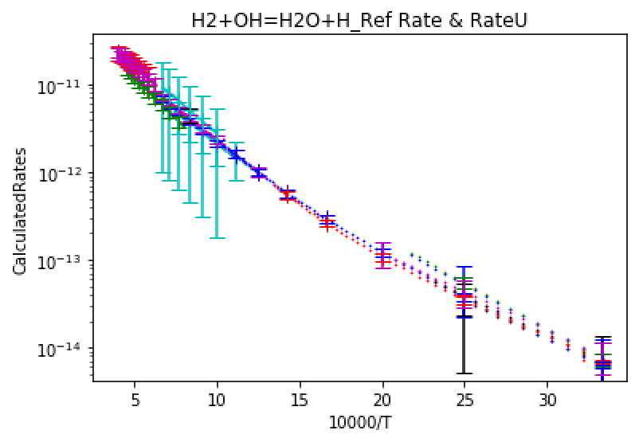
Rate evaluation example: H₂ + OH = H₂O + H reaction
A: 1.57(±0.08)E-12 cm3/molecule/s
n: -1.601 (±0.025)
E: 13.76(±0.15) kJoule/mol

Slide 5
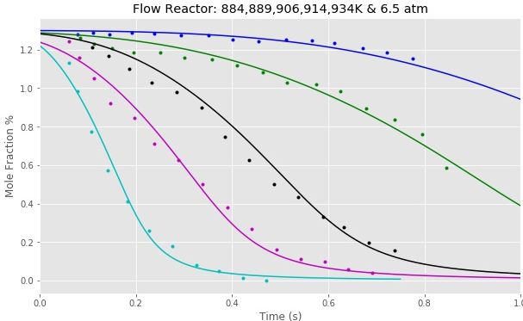
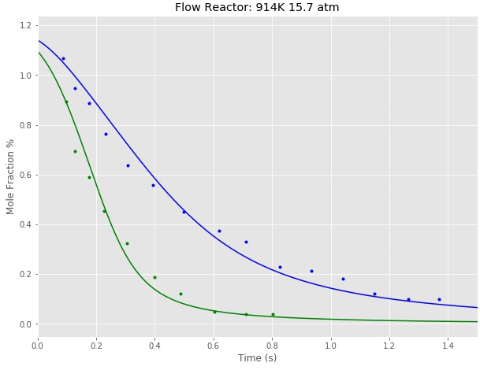


Model Performance example: flow reactor experiments

Slide 6
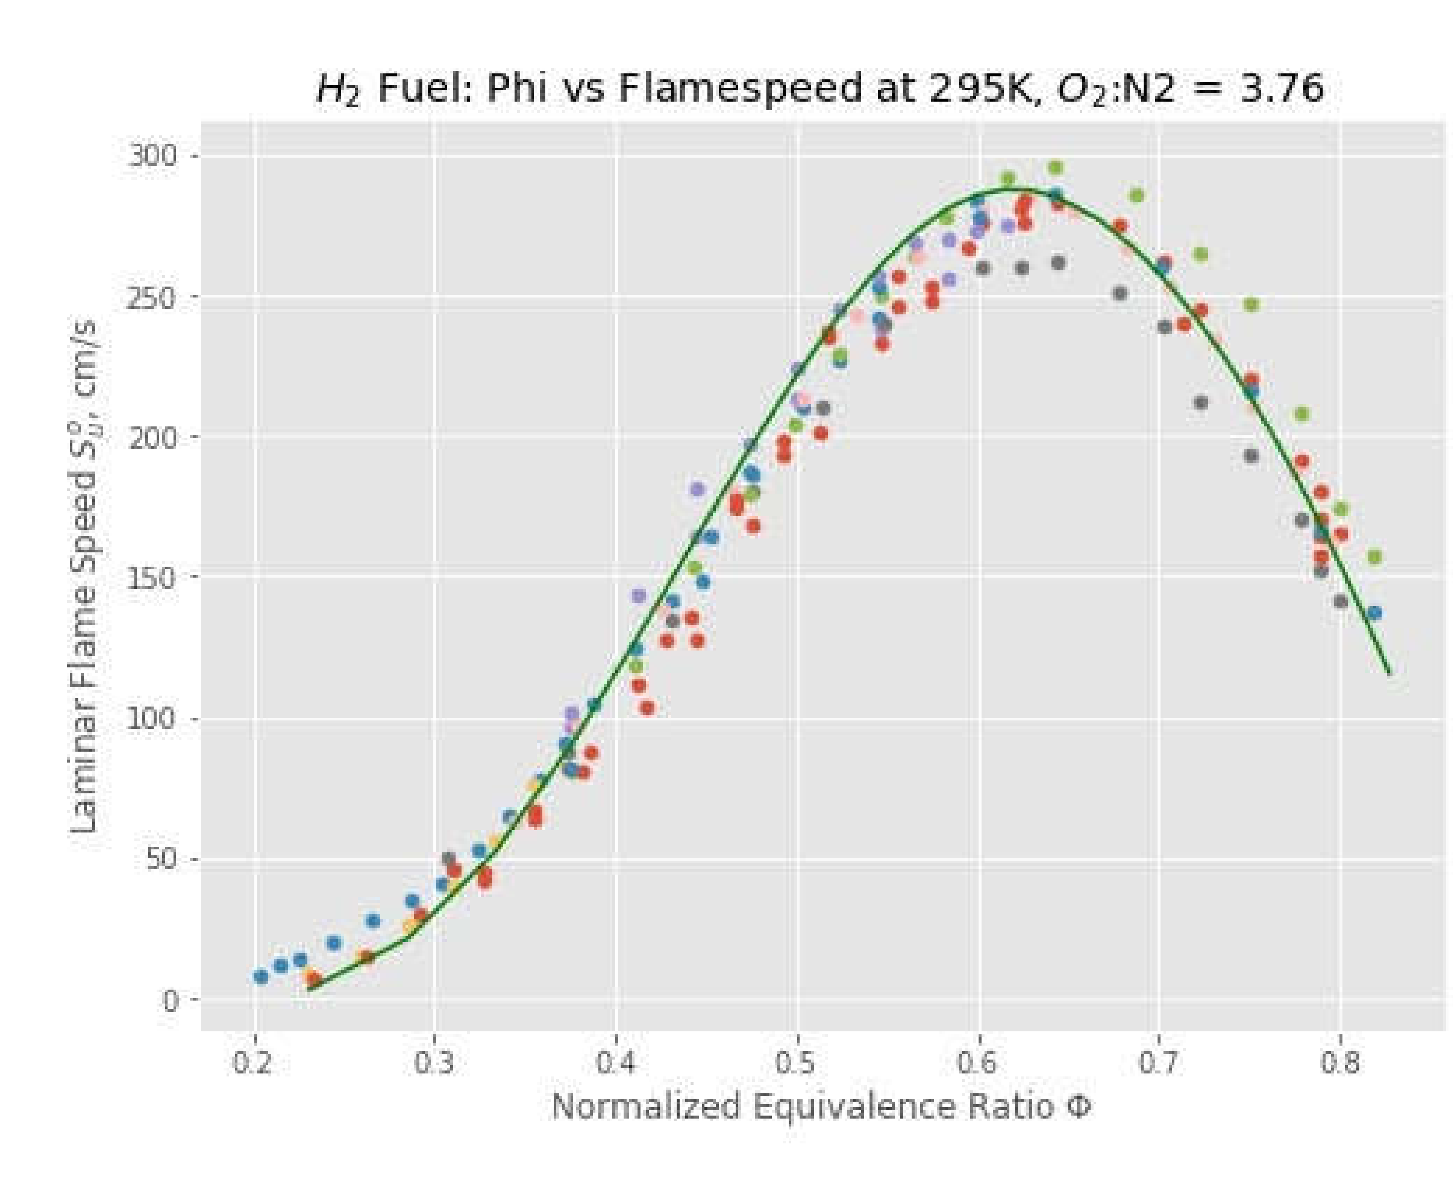
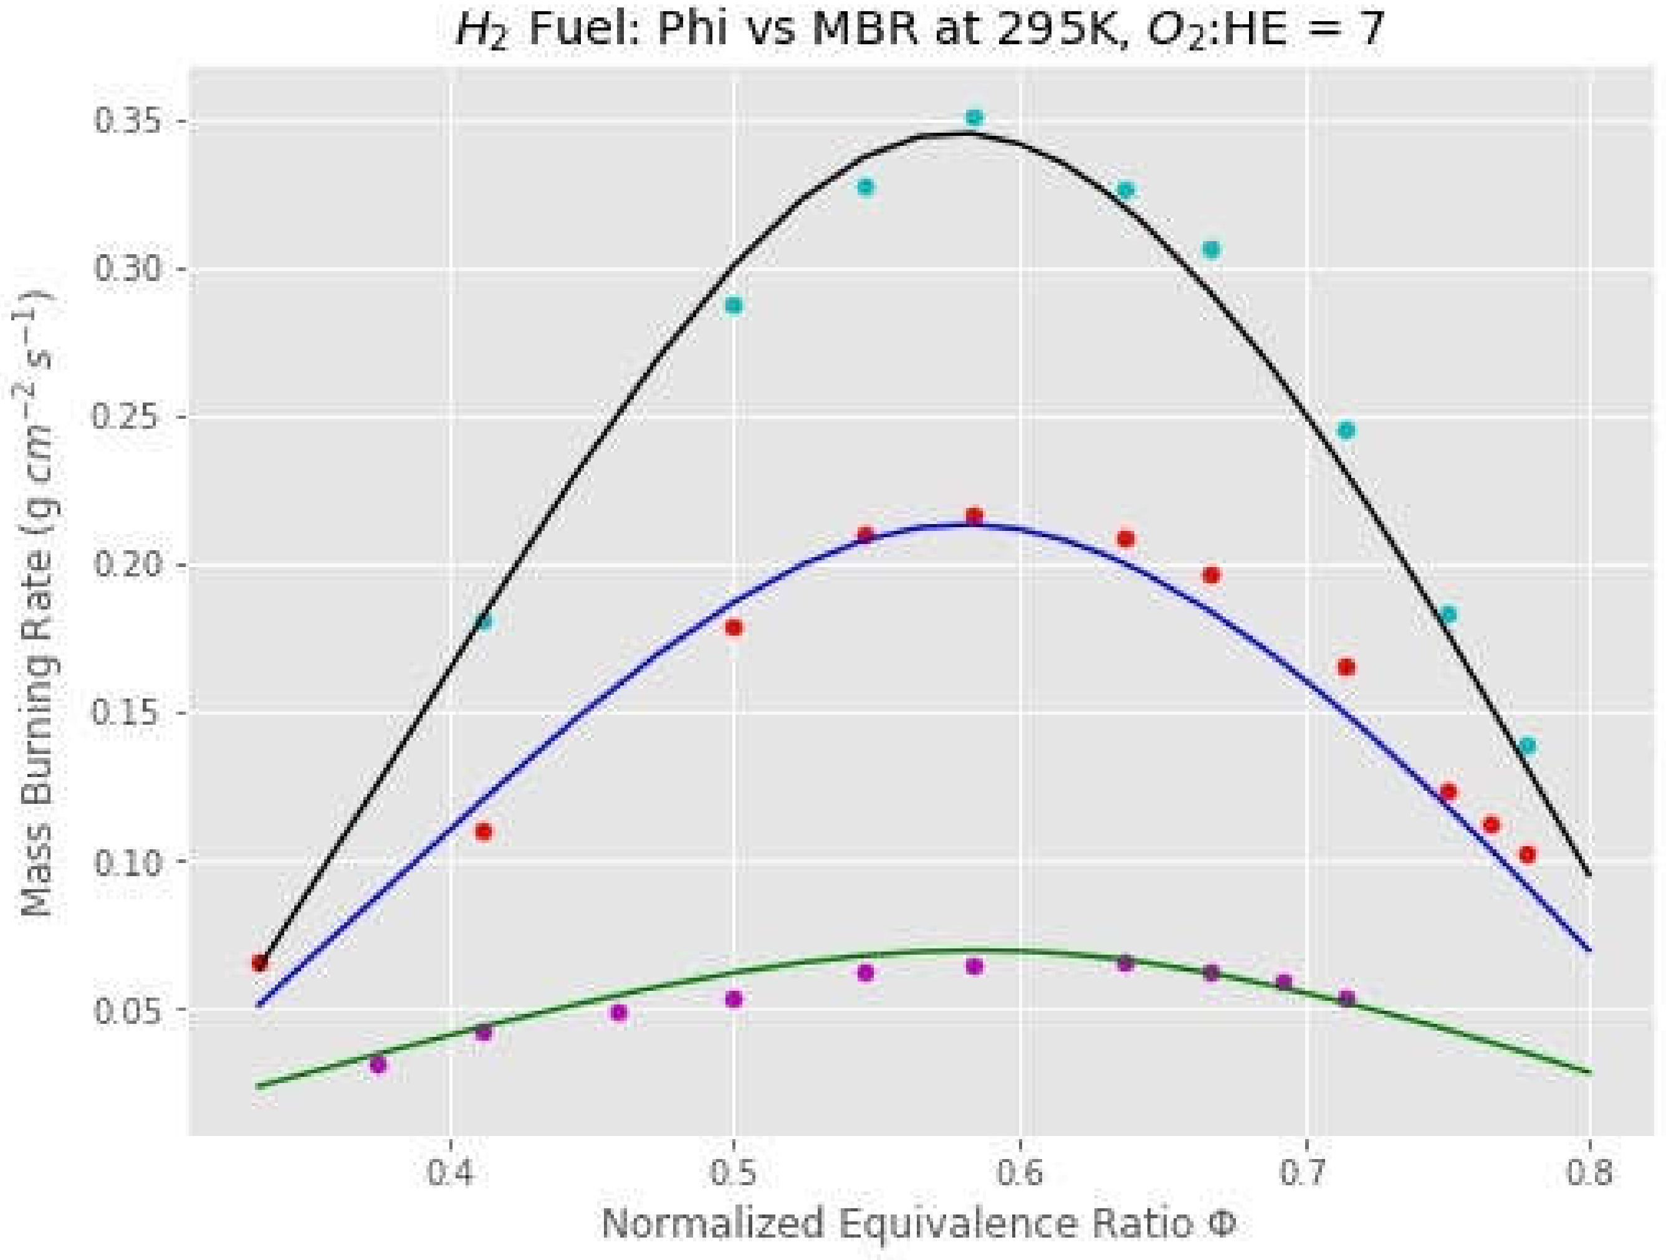
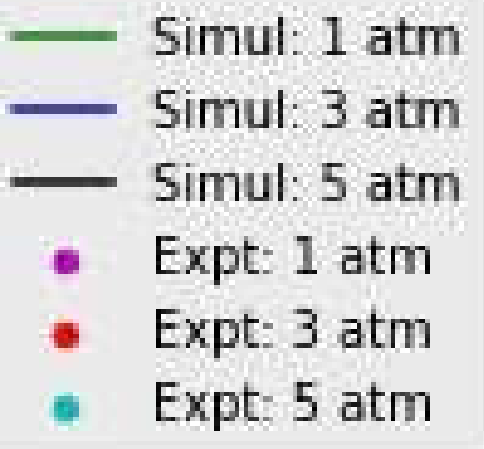
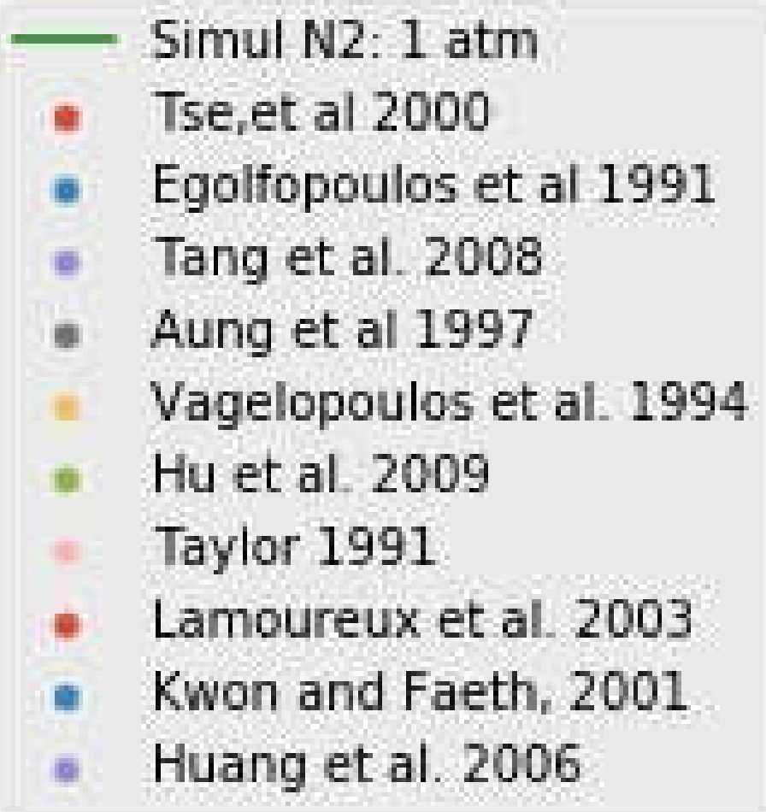
Model Performance example: flame speed experiments

